Slide 1
A DEEP DIVE INTO DARK DECADE OF MANCHESTER UNITED

Slide 2

DATA VIZUALIZATIONS IN FOOTBALL
Data visualization is the process of translating large data sets and metrics into charts, graphs and other visuals.
In football, it has many applications right from detecting a small flaw in a player’s technique to devising game-plans to outsmart an opponent and expose his weakness.
Nowadays with advanced and complex metrics like xG, xThreat and Shot Creating Actions (SCA) one micro-analyse and break down a game far efficiently.
VIZUALIZATION COVERED IN THIS PROJECT
Pizza Plot
Bumpy
Scatter Plot
Swarm Plot
Radar Plot
Squarify Plot

Slide 3
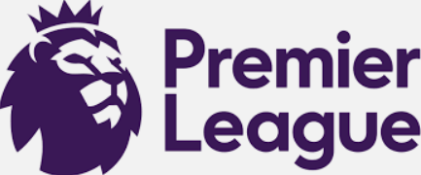
COMPETITIONS COVERED
WHY PREMIER LEAGUE?
The Premier League is played in a round-robin format where 20 teams face each other twice in a home-away format.
Tournaments like UEFA Champions League play group stage and then a knockout format thereafter. Teams from lower ranked European leagues qualify for it as well which means data could be highly inconsistent depending on the strengths of these team
Domestic Cup like FA Cup and League Cup play knockout format as well where teams belonging to as low as tier 10 participate

Slide 4

DATASETS
There are few sites that process free access to football data like Understat.com, Fbref.com etc
For this project the datasets used are from Fbref.com – as it provides access to advanced metric like xG
Also the scope to provide clean datasets helps in the visualization process

Slide 5
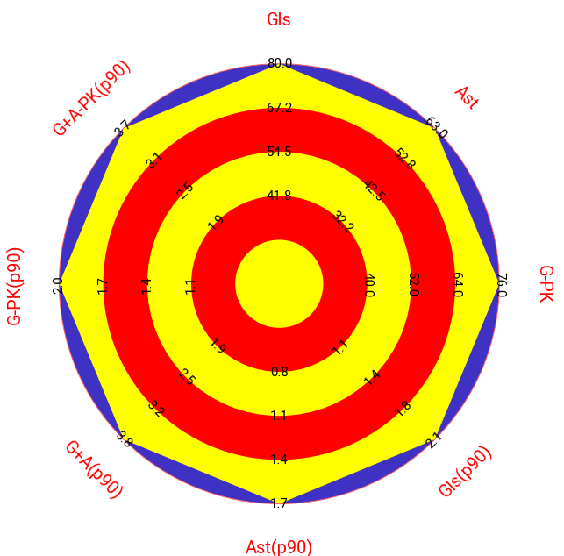
2012-2013
RADAR CHART
The Radar Chart gives an general idea about how dominant Sir Alex Ferguson’s team were in Premier League during his 26 years tenure. Man Utd dominated every attacking stat during this season as romped through 13th PL title under Ferguson.

Slide 6

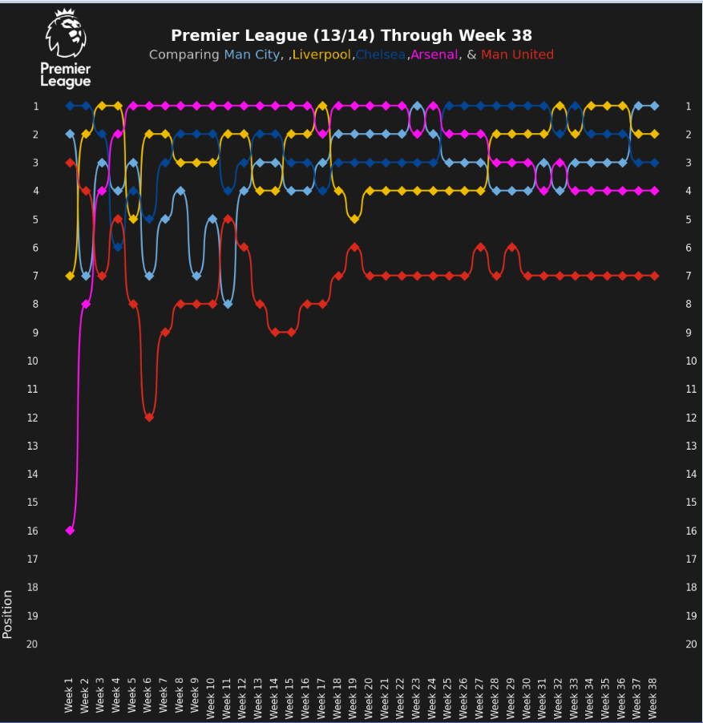
2013-2014
BUMPY
An ageing squad badly in need of transistion and SAF leaving Man Utd took a toll on the successor David Moyes. As they succumed to a poor 7th place missing out on European places
l

Slide 7
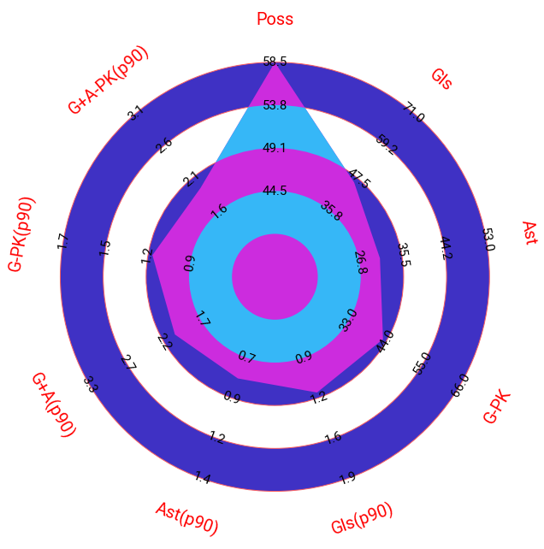
2014-2015
RADAR CHART
Man Utd’s passing quality showed slight improvement than previous season. They became a possession heavy and topped the chart for the same. Althought this approach caused many games ending in goalless draws, also lack of quality forwards/creative options led to it
l

Slide 8
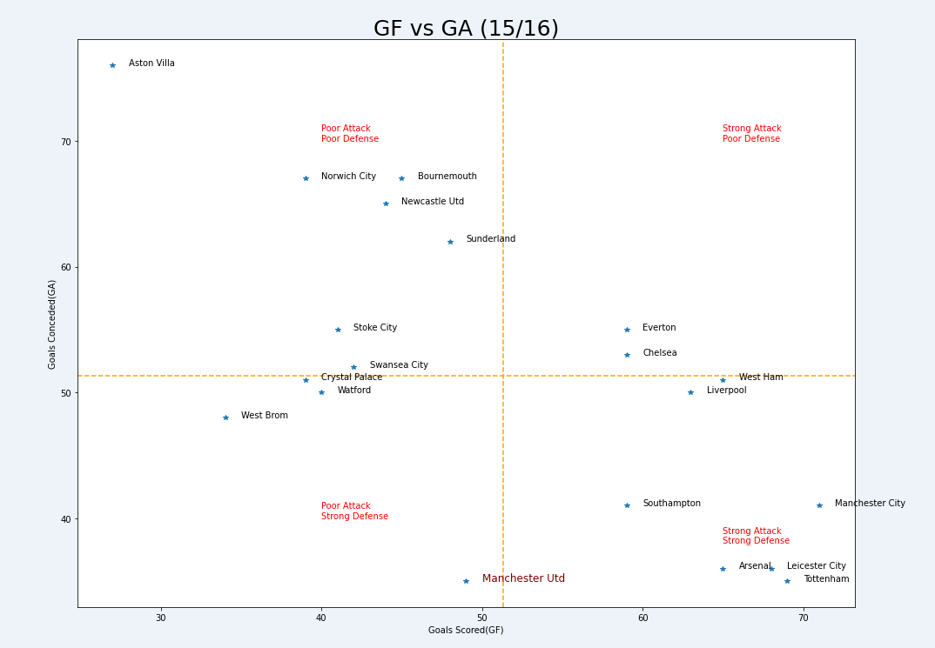
2015-2016
l
SCATTER PLOT-
United altho conceded the joint least goals (35) in PL it came at the price of being underwhelming in attack – scoring only 49 goals which well below PL average

Slide 9
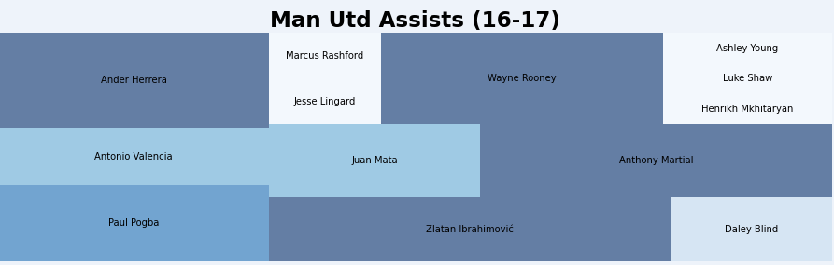
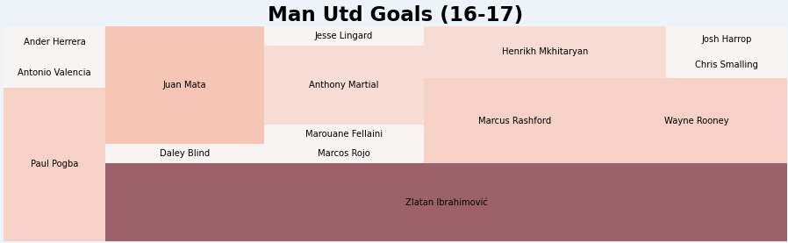
2016-2017
SQUARIFY
2016-17 saw the arrival of Jose Mourinho at the helm. United became a better side in terms of creativity and arrival of Zlatan Ibrahimovic galored up goals upfront ,with Paul Pogba helping United’s creativity.

Slide 10
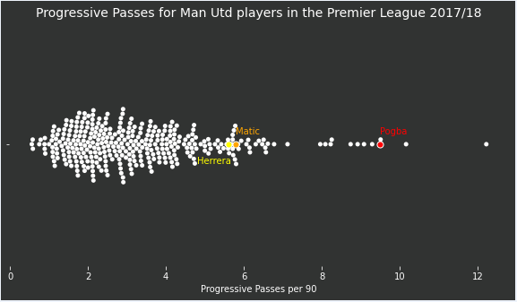
2017-2018
SWARM PLOT
United became a massive reliant on their preferred midfield for progressing the ball upfront. With defence not that great in progression of the ball, the onus was on these 3 – Matic, Pogba,Herrera. This midfield actually helped them push their way to finish second

Slide 11
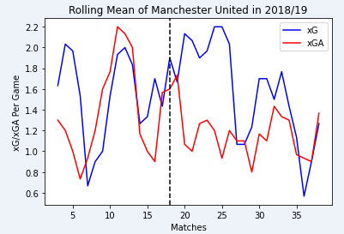
2018-19
RUNNING PLOT(ROLLING MEAN)
United saw a sharp decline this season under Jose Mourinho which ultimately led to his sacking. When caretaker manager Ole Gunnar Solkskjaer took charge from the 18th game, United performance improved drastically with a huge difference in xG and xGA. There came a sharp decline in the last few games of the season, mainly due to the poor fitness of the squad, mainly due the fitness method of the previous regime.

Slide 12
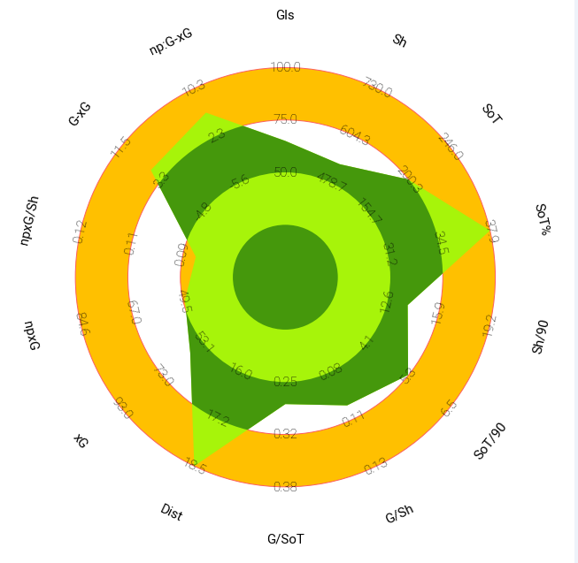
2019-20
RADAR PLOT
United were the best team when it came to covering the Distance. The attack became far more well rounded. As massive progress was seen from previous season.

Slide 13
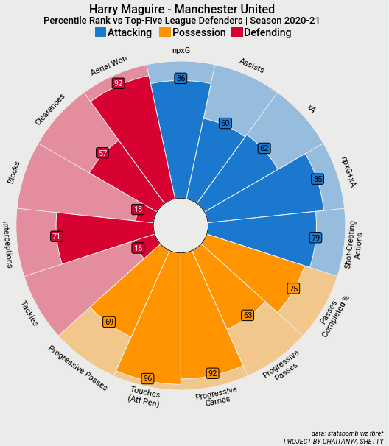
2020-2021
PIZZA PLOT(PERCENTILE)
Harry Maguire was one the best defenders in the top five leaves. He was one of the best ball playing CB in Europe being in the 96th and 92th percentile for Touches(Att Pen) and Progresssive Carries respectively. United managed to finish 2nd this season with sustained improvement in other aspects as well

Slide 14
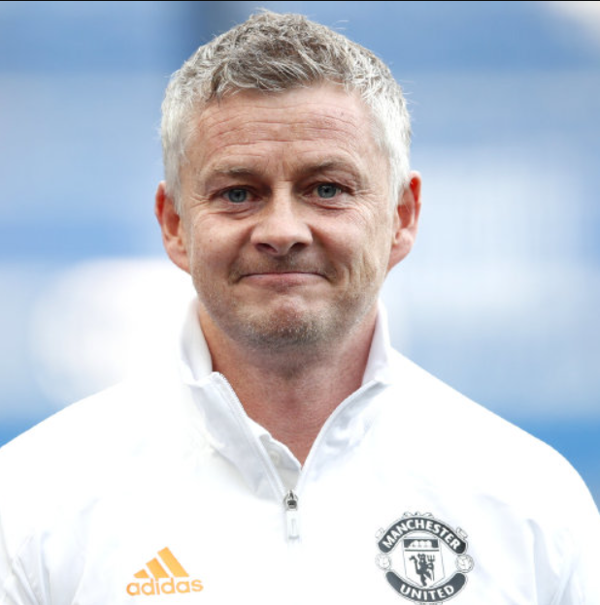
CONCLUSION
Ole Gunnar Solskjaer’s has helped resurrect Manchester United and their fortunes.
They have shown steady signs of improvement under him
The 21/22 summer window will be really key to decide where the project is headed to.

